Slide 1
Programmers
Story Archive of Bangladesh

Slide 2
Outline
What we want to do?
Why we want to do it?
How we are going to do it?
What we need to do it?

Slide 3

WHAT?
Archiving the stories of pioneer programmers of Bangladesh and Inspiring the new generation by them.

Slide 4
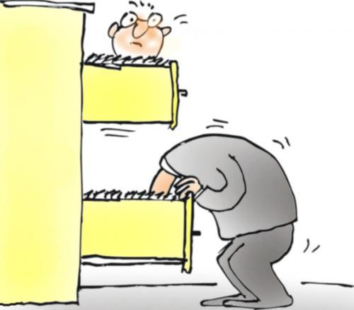
Why?
Archiving the stories of pioneers.

Slide 5

Why?
Letting people know about them.

Slide 6

Why?
Inspiring new generation.

Slide 7

Why?
Guiding them with real advice.

Slide 8
HOW?
1. Making a list of people we want to reach.
2. Compiling the Questions we want to ask.
3. Getting appointment time from them.
4. Sending the team.
5. Taking the interview and recording it.
6. Rewriting the interview.
7. Archiving and publishing later on.

Slide 9





Needs?
Data: Names, contacts of people we want to reach.
Questions: A good set of questions
Team: A skillful team to manage the interview process(Taking, Writing, Publishing)
Commute: Necessaries to maintain the commute.
Publication: Publish online and hardcopy

Slide 10
Thank you

